Slide 1
UNIT3.
Interaction Modeling

Slide 2
Introduction (1)
Third leg of the modeling tripod.
It describes interaction within a system.
The class model describes the objects in a system and their relationships the state model describes the life cycles of objects, the interaction model describes how objects interact.
The interaction model describes how objects interact to produce useful results.
Both state model and interaction model are needed to describe behavior fully. They complement each other by viewing behavior from two different perspectives.

Slide 3
Introduction (2)
Interactions can be modeled at different levels of abstraction.
At a higher level use cases describe how a system interact with outside actors.
  Each use case represents a piece of functionality that a system provides to its users.
  Use cases are helpful for capturing informal software requirements.
Sequence diagrams provide more details and show the messages exchanged among a set of object over time. Message include both asynchronous signals and procedure call. They are good for showing the behavior sequences seen by users of a system

Slide 4
Introduction (3)
Finally, Activity diagrams provide further details and show the flow of control among the steps of computation.
Activity diagrams can show data flows as well as control flows.
Activity diagrams document the steps necessary to implement an operation or a business process.

Slide 5
System perspectives
An external perspective, where you model the context or environment of the system.
An interaction perspective, where you model the interactions between a system and its environment, or between the components of a system.
A structural perspective, where you model the organization of a system structure of data flow.
A behavioral perspective, where you model the dynamic behavior of the system and how it responds to events.
Chapter 5 System modeling

Slide 6
UML diagram types
Use case diagrams, which show the interactions between a system and its environment.
Sequence diagrams, which show interactions between actors and the system and between system components.

Slide 7
Use case modeling
Use cases were developed originally to support requirements elicitation and now incorporated into the UML.
Each use case represents a discrete task that involves external interaction with a system.
Actors in a use case may be people or other systems.
Represented diagrammatically to provide an overview of the use case and in a more detailed textual form.
Chapter 5 System modeling

Slide 8

Transfer-data use case
A use case in the MHC-PMS
Chapter 5 System modeling

Slide 9
Use Case Models: Actors (1)
  An actor is a direct external user of a system
    An object or a set of objects that communicates directly with the system but that is not a part of the system.
    Each actor represents those objects that behave in a particular way toward the system.
    Examples:
      Vending Machine
        Customer
        Repair technician
      Computer Database system
        User
        Administrator

Slide 10
Use Case Models: Actors (2)
Actors can be persons, devices, and other systems
An actor has a single well-defined purpose (role).
An actor represents a particular facet (وجه من وجوه)of objects in its interaction with a system,
Each actor represents a coherent set of capabilities for its objects.
Modeling the actors helps to define a system by identifying the object within the system and those on its boundary.
An actor is directly connected to the system.

Slide 11
System boundaries
System boundaries are established to define what is inside and what is outside the system.
  They show other systems that are used or depend on the system being developed.
The position of the system boundary has a profound effect on the system requirements.
Defining a system boundary is a political judgment
  There may be pressures to develop system boundaries that increase / decrease the influence or workload of different parts of an organization.

Slide 12
Use Case Models: Use cases (1)
A use case is a coherent piece of functionality that a system can provide by interacting with actors.
Example:
  A customer actor can buy a beverage from a vending machine: it inserts money into machine, make a selection, and ultimately receive a beverage and eventually change.
Each use case involves one or more actors as well as the system itself:
  In a telephone system, the use case “make a call” involves two actors, a caller and a receiver.
ِA use case involves a sequence of messages among the system and its actors.
  A customer inserts a coin and the vending machine displays the amount deposited…….. Then the customer pushes a button to indicate a selection; the vending machine dispenses the selected beverage and issues change if necessary

Slide 13
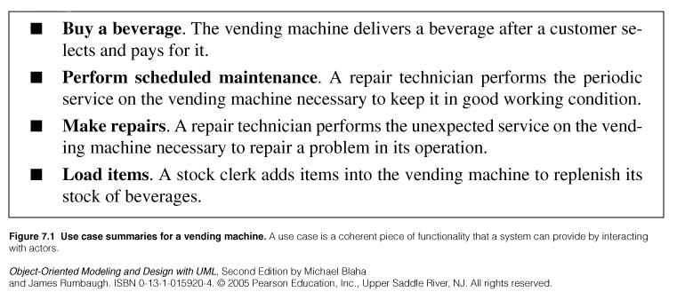
Use Case Models: Use cases (2)

Slide 14
Use Case Models: Use cases (3)
Some use cases have a fixed sequence of messages.
Error conditions are also part of a use case:
  Examples:
    Selecting a beverage whose supply is exhausted , the vending machine displays a warning message
    Vending transaction can be canceled
The designer should plan for all possible behaviors sequences. User errors, or resource failures are just additional kinds of behavior that a robust system can accommodateز

Slide 15
Use Case Models: Use cases (4)
A use case brings together all of the behavior relevant to a slice of a system functionality:
  This includes normal mainline behavior, variations on normal behavior, exceptions conditions, error conditions, and cancellation of a requestز
  Grouping normal and abnormal behavior under a single use case helps to ensure that all consequences of an interaction are considered together.
In a complete model, the uses cases partition the functionality of the systems:
  They should preferably all be at a comparable level of abstraction:
    Make phone call, record voice message are comparable levels
    Set external speaker volume to high is too narrow.
    Better to define a use case set telephone parameters under which we might regroup setting volume, display pad settings, setting clock….

Slide 16
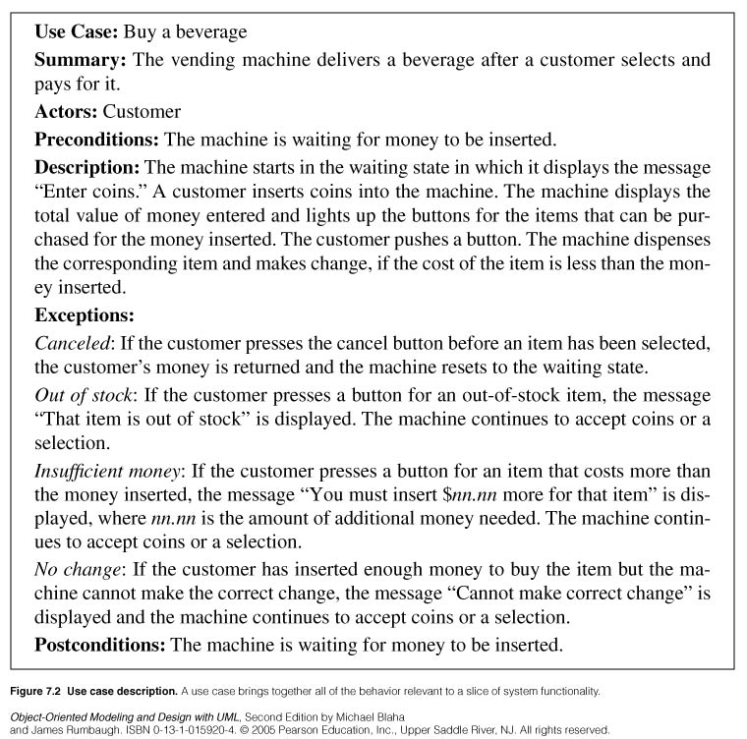

Slide 17
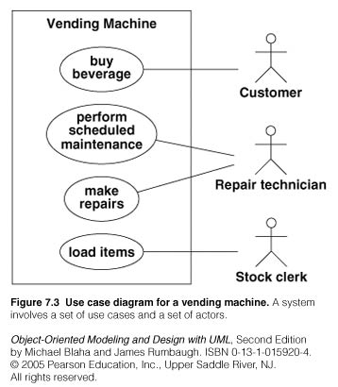

Slide 18
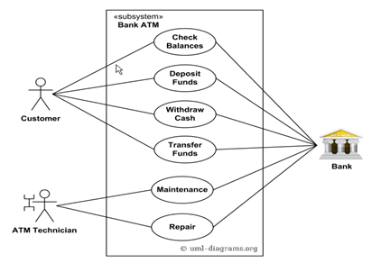
Design a Use-case diagram for Bank ATM system.
Chapter 5 System modeling

Slide 19
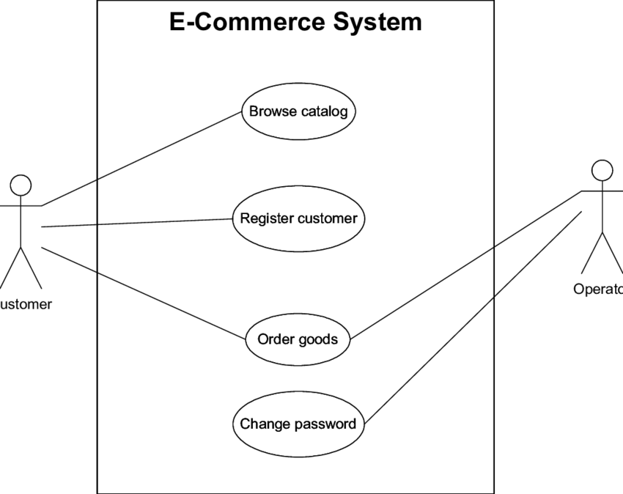
Chapter 5 System modeling

Slide 20
Guidelines for use case Models
First determine the system boundary
Ensure that actors are focused:
  Each actor should have a single, coherent purpose. If a real-world object embodies multiple purposes, capture them with separate actors. For example, the owner of a personal computer may install software, set up a database, and send email. These functions differ greatly in their impact on the computer system and the potential for system damage. They might be broken into three actors: system administrator, database administrator, and computer user. Remember that an actor is defined with respect to a system, not as a free-standing concept.
Each use case must provide value to users:
  Should represent a complete transaction that produces value to users.
  Ex: dial a phone number is not a good use case. It does not represent a complete transaction of value by itself. It s merely a part of the use case make a call.

Slide 21
Guidelines for use case Models
Relate use cases and actors:
  Each use case should have at least one actor
  Every actor must participate in at least one use case
  A use case may involve several actors (one of them is the primary actor and the others are the secondary actors)
  An actor may participate in several use cases.
Remember that use cases are informal
  Is acceptable if use cases are a bit loose at first. Detail can come later as use cases are expanded and mapped into implementations.
Use cases can be structured.

Slide 22
Scenarios
› A scenario is a sequence of events that occurs during one particular execution of a system
› A scenario highlights the interaction between different objects in a system through a set of steps
The steps can be defined at high level at the beginning
At later stages the steps can be refined through the specification of messages exchanged between objects and activities performed by the objects within the system
› In a use case description you write one mainstream scenario and one or more exceptional scenarios

Slide 23
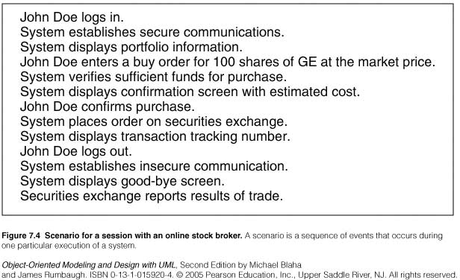
Scenarios
› Writing a scenario
Identify the objects involved
Determine the sender and the receiver of each message
Determine the sequence of the messages
Add activities

Slide 24
Sequence diagrams
Sequence diagrams are part of the UML and are used to model the interactions between the actors and the objects within a system.
A sequence diagram shows the sequence of interactions that take place during a particular use case or use case instance.
The objects and actors involved are listed along the top of the diagram, with a dotted line drawn vertically from these.
Interactions between objects are indicated by annotated arrows.

Slide 25
Sequence Diagrams
› A sequence diagram shows the participants in an interaction and the sequence of messages among them
› A sequence diagram shows the interaction of a system with its actors to perform a use case

Slide 26
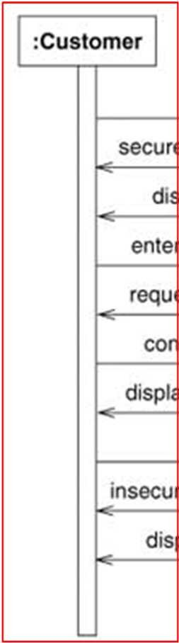
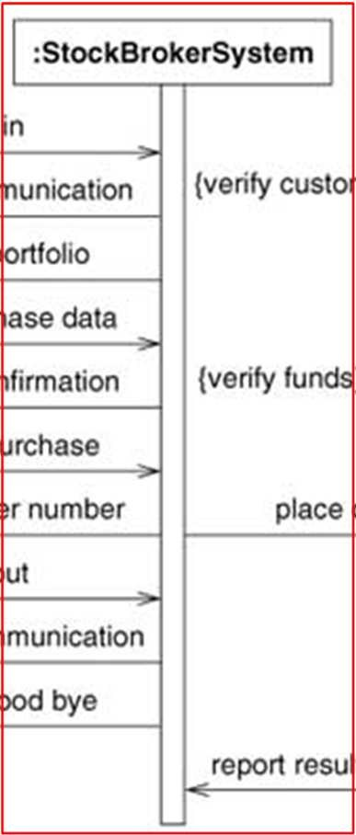
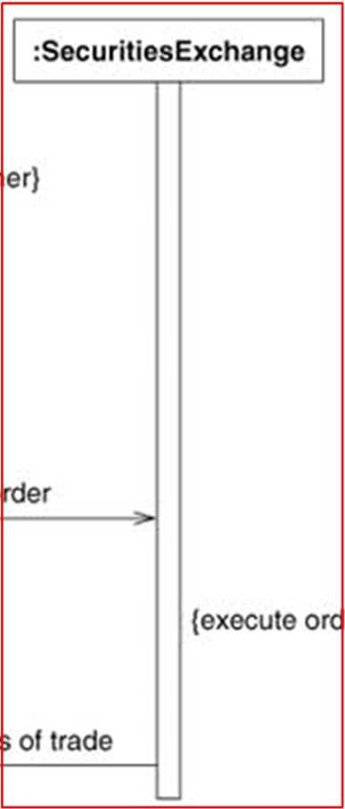
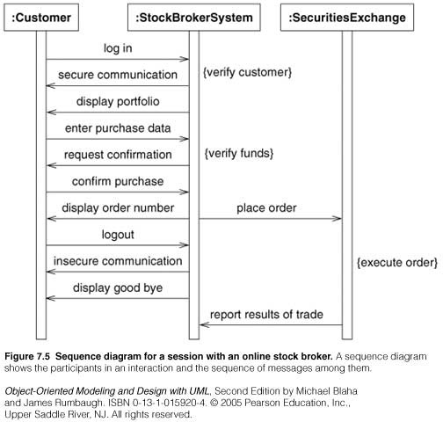
Sequence Diagrams (Asynchronous)
Actors as well as the System are represented by a vertical line called a lifeline

Slide 27
Sequence Diagrams (Asynchronous)
Time proceeds from top to bottom but spacing is irrelevant
6

Slide 28

Sequence Diagrams (Asynchronous)
Each message is a horizontal arrow from the sender to the receiver

Slide 29
Sequence Diagrams (Asynchronous)
Are used for high level interactions
Can contain concurrent signals
  Stock Broker System sends messages to Customer and Securities Exchange concurrently
Signals between participants do not need to alternate
  Stock Broker System sends “secure communication” followed by “display portfolio”

Slide 30
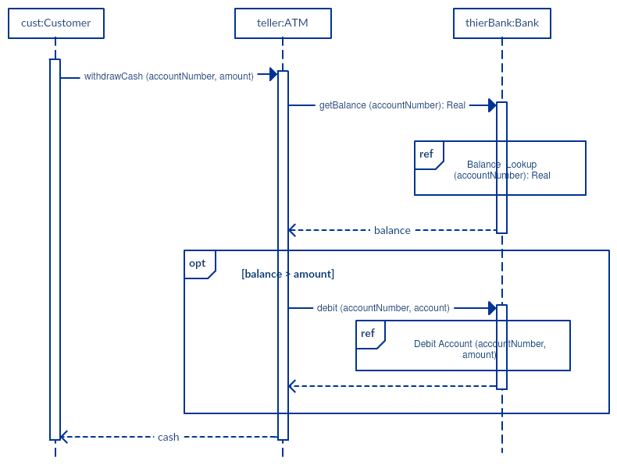

Slide 31
Guidelines for Sequence Models
◆ Prepare at least one scenario per use case
◆ Abstract the scenarios into sequence diagrams: The seq. diagram clearly show the contribution of each actor.
◆ Divide complex interaction:
◆ Prepare a sequence diagram for each error condition.

Slide 32
Activity Models
Useful to specify software or hardware system behaviour
Based on data flow models – a graphical representation (with a Directed Graph) of how data move around an information system

Slide 33
Overview
An activity diagram visually presents a series of actions or flow of control in a system similar to a flow-chart or a data flow diagram. Activity diagrams are often used in business process modeling.
Contrary to use case diagrams, in activity diagrams it is obvious whether actors can perform business use cases together or independently from one another

Slide 34
Purpose:
Draw the activity flow of a system.
Describe the sequence from one activity to another.
Describethe parallel,branched and concurrent flow of the system.

Slide 35
How to draw Activity Diagram?
Before drawing an activity diagram we should identify the following elements:
Initial State or Start Point
Activity or Action State
Object Flow
Decisions and Branching
Synchronization
Final State or End Point

Slide 36

Initial State or Start Point
A small filled circle followed by an arrow represents the initial action state or the start point for any activity diagram.

Slide 37
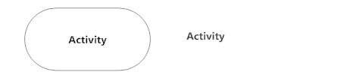
Activity or Action State
 An action state represents the non-interruptible action of objects.

Slide 38

Action Flow
Action flows, also called edges and paths, illustrate the transitions from one action state to another

Slide 39

Decisions and Branching
A diamond represents a decision with alternate paths. When an activity requires a decision prior to moving on to the next activity, add a diamond between the two activities.

Slide 40
Synchronization
A fork node is used to split a single incoming flow into multiple concurrent flows. It is represented as a straight, slightly thicker line in an activity diagram.
A join node joins multiple concurrent flows back into a single outgoing flow.
A fork and join mode used together are often referred to as synchronization.

Slide 41
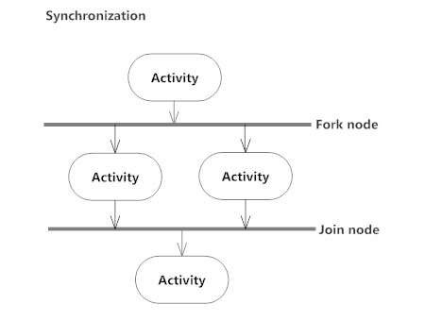

Slide 42

Final State or End Point
 An arrow pointing to a filled circle nested inside another circle represents the final action state.

Slide 43
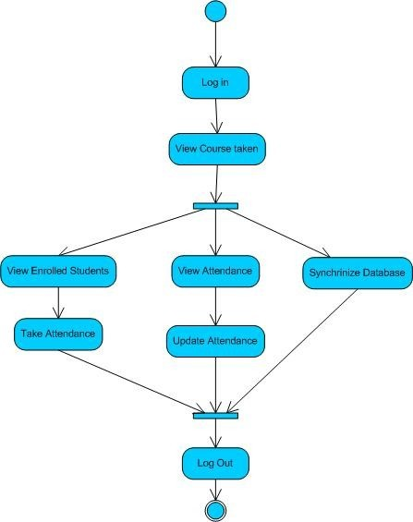
Activity Diagram of Attendance Management System

Slide 44
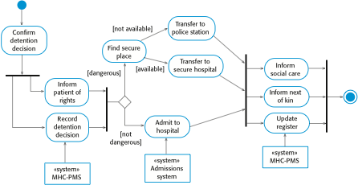
Activity model for hospital management
Chapter 5 System modeling

Slide 45
Guidelines for Activity model
Don’t misuse Activity Diagrams
Level Diagrams
Be careful with branches and conditions
Be careful with concurrent activities

Slide 46
Advanced Use case relationships
“Include: relationship:
The include relationship incorporates one use case within the behavior sequence of another use case.
ِAn included use case is like a subroutine :
  It represents behavior that would otherwise have to be described more than once in the same use case behavior sequence or in more than one use case behavior sequence.
  It represents a fragment use case that often is a meaningful unit of behavior for the actors, although this is not required.
Both textual and graphical notation exist to represent an include relationship.
  It may be inserted within a textual description with the notation:
  include use case name

Slide 47
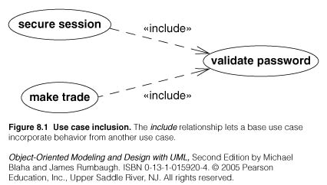
Include relationship
An included use case is inserted in a specific location within the behavior sequence of the larger use case.
Factoring a use case into pieces is appropriate when the pieces represent significant behavior units.
Figure 8.1 shows an example from an online stock brokerage system. Part of establishing a secure session is validating the user password. In addition, the stock brokerage system validates the password for each stock trade. Use cases secure session and make trade both include use case validate password.

Slide 48
Extend relationship
The “extend” relationship adds incremental behavior to a use case.
It is like an include relationship looked at from the opposite direction:
  The extension adds itself to the base rather than the base explicitly incorporating the extension.
  It represents the frequent situation in which some initial capability is defined and later features are added modularly.
The include and extend relationships both add behavior to a base use case.

Slide 49
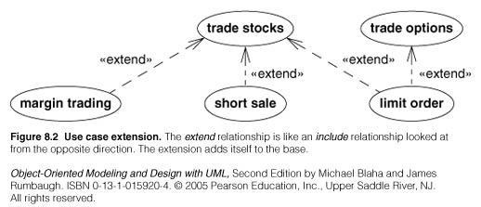
Extend relationship
For example, a stock brokerage system might have the base use case trade stocks, which permits a customer to purchase stocks for cash on hand in the account. The extension use case margin trading would add the ability to make a loan to purchase stocks when the account does not contain enough cash. It is still possible to buy stocks for cash, but if there is insufficient cash, then the system offers to proceed with the transaction after verifying that the customer is willing to make a margin purchase. The additional behavior is inserted at the point where the purchase cost is checked against the account balance.

Slide 50
Extend relationship
Figure 8.2 shows the base use case trade stocks for a stock brokerage system. The UML notation for an extend relationship is a dashed arrow from the extension use case to the base use case. The keyword «extend» annotates the arrow.
The base use case permits simple purchases and sales of a stock at the market price. The brokerage system adds three capabilities: buying a stock on margin, selling a stock short, and placing a limit on the transaction price. The use case trade options also has an extension for placing a limit on the transaction price.

Slide 51
Extend relationship
The extend use case is often a fragment so it cannot appear alone as a behavior sequence.
The extend relationship can specify an insert location within the behavior sequence of the base use case:
  The location can be a single step in the base sequence or a range of steps .
  The behavior sequence of the extension occurs at the given point in the sequence.
In most cases an extend relationship has a condition attached:
  The extension behavior occurs only if he condition is true when control reaches the insert location.

Slide 52
Generalization relationship
Generalization can show specific variations on a general use case, analogous generalization between classes.
A parent use case represents a general behavior sequence.
Child use cases specialize the parent by introducing additional steps or by refining steps.
A parent use case may be an abstract use case or a concrete use case.
An abstract use case cannot be used directly.
A child use case can add behavior steps but they must be appear in the proper locations within the behavior sequence of the parent.

Slide 53
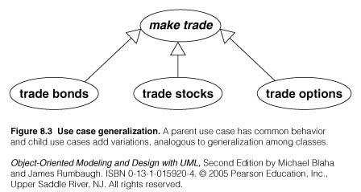

Slide 54
Generalization relationship
A more general approach is to assign symbolic locations within the parent sequence and to indicate where additions and replacements go.
In general a child revise behavior subsequences at several different points of the parent sequence.

Slide 55
Combination of use cases
A single diagram may combine different kinds of use case relationships.

Slide 56
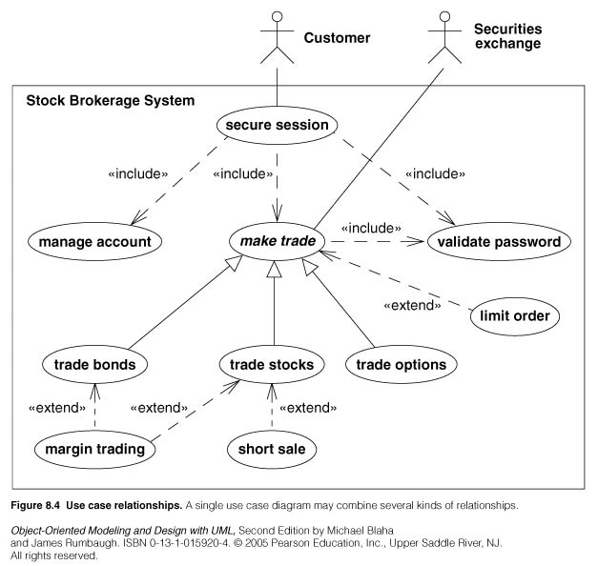

Slide 57
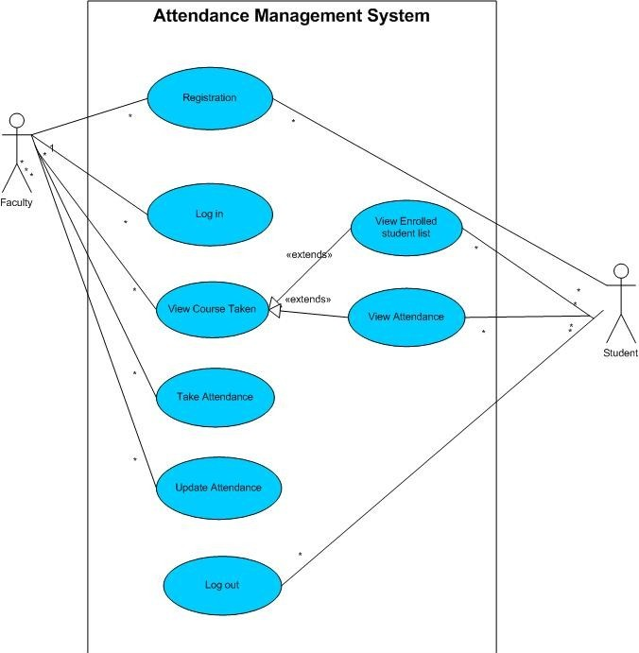
Attendance Management System

Slide 58
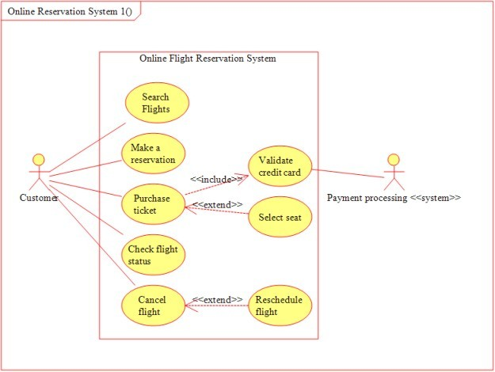
UML 84

Slide 59
Guidelines for use case relationships
Use case generalization:
  If a use case comes in several variations model the common behavior with an abstract use case and then specialize each of the variations.
  Don’t use generalization simply to share a behavior fragment.

Slide 60
Guidelines for use case relationships
Use case inclusion:
  If a use case includes a well defined behavior fragment that is likely to be useful in other situations, define a use case for the behavior fragment and include it in the original use case.
  In most cases, you should think of the included use case as a an meaningful activity but not as an end in itself.

Slide 61
Guidelines for use case relationships
Use case extension:
  If you can define a meaningful use case with optional features then model the base behavior as a use case and add features with the extend relationships.
  Use the extend relationship when a system might be deployed in different configurations, some with additional features others without them.

Slide 62
Guidelines for use case relationships
Include versus extend relationships:
  Both factor behavior into small pieces.
  The include relationships implies that the included behavior is a necessary part of the configured system (even if the behavior is not executed every time).
  The extend relationship implies that a system without the added behavior would be meaningful (even there is no intention to configure it that way)

Slide 63
Procedural Sequence Models
Sequence Diagrams with Passive Objects.
A passive object is not activated until it has been called.
Most implementation are procedural and limit the number of objects that can execute at a time.
Sequence diagrams can show procedure calls.
An object is activated only when it is called. Once the execution of an operation completes the control returns to the caller and the object becomes inactive

Slide 64
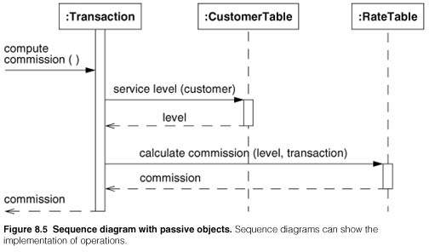
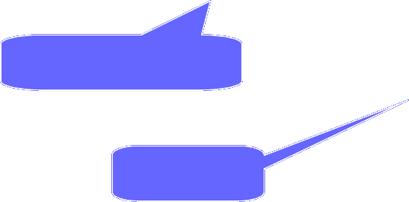
Procedural Sequence Models
activation
Procedure call
return

Slide 65
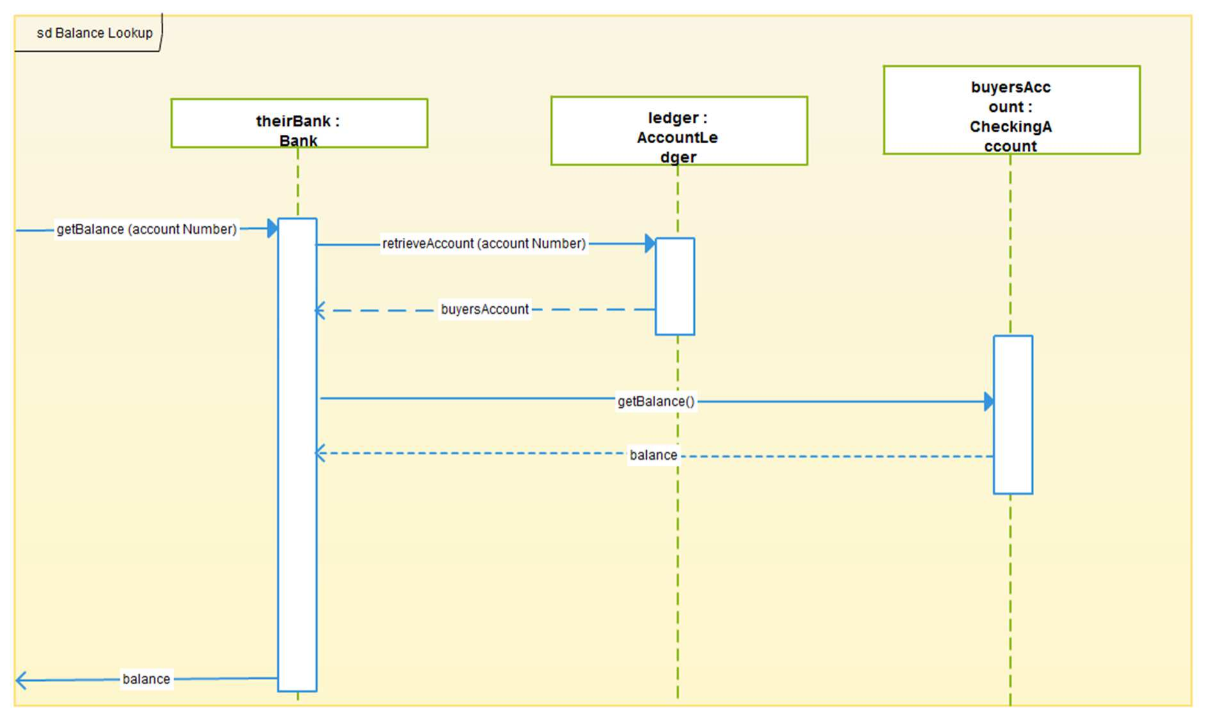
Sequence Diagram with passive objects

Slide 66
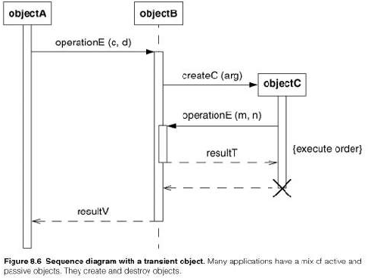
Sequence Diagrams with Transient Objects
  An active object
Passive
  object
Transient object
Destroy

Slide 67
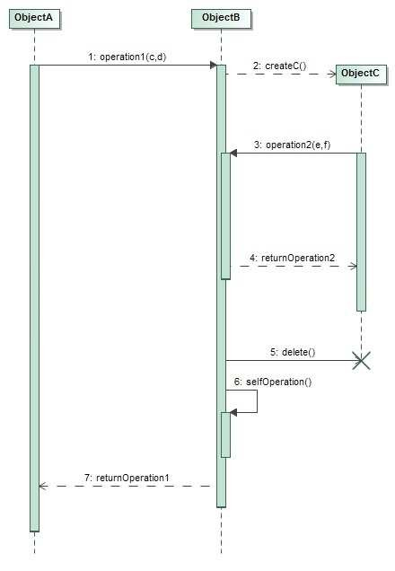
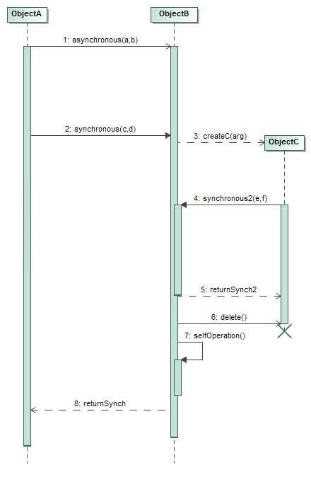
Sequence Diagrams with transient objects
Most implementation are procedural and limit the number of objects that can execute at a time
Sequence diagrams can show procedure calls
An object is activated only when it is called. Once the execution of an operation completes the control returns to the caller and the object becomes inactive

Slide 68
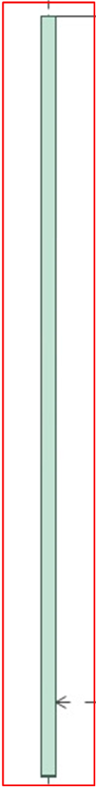
Sequence Diagrams with transient objects
The period of time of an object’s execution is a thin rectangle called activation or focus of control

Slide 69
Sequence Diagrams with transient objects
An activation shows the time period during which a call of a method is processed including the time when the called method invoke other methods

Slide 70
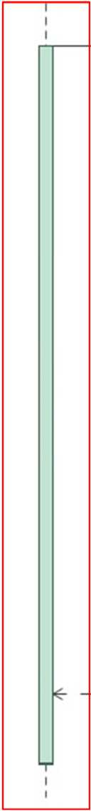
Sequence Diagrams with transient objects
The entire period of time when an object exists is called lifeline

Slide 71
Sequence Diagrams with transient objects
The notation for a call (synchronous message) is an arrow from the calling activation to the activation created by the call.The filled arrowed indicates a call (as opposed to the stick arrowhead for an asynchronous signal)

Slide 72
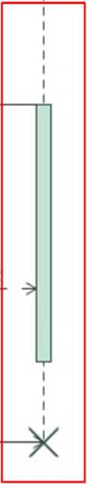
Sequence Diagrams with transient objects
Objects A and B exist during the entire time shown in the diagram, whereas object C is created and destroyed in a smaller period of time.
Therefore, its lifetime does not span the whole diagram

Slide 73
Sequence Diagrams with transient objects
If an object does not exist at the beginning of the sequence diagram, it must be created. UML shows creation by placing the object symbol at the head of the dashed arrow representing the call that creates the object

Slide 74
Sequence Diagrams with transient objects
A large ‘X’ marks the end of the life of an object that is destroyed during the sequence diagram.The ‘X’ is placed at the head of the call arrow that destroys the object

Slide 75
Sequence Diagrams with transient objects
An object can call its own operations (self calls)

Slide 76
Guidelines For Procedural Sequence Models
Active vs. Passive objects: Most of the are passive and lack their own thread of control. By Definition active objects are always activated and have their own focus of control.
Advanced features: Be selective in using advanced features.

Slide 77
Special constructs for activity diagrams
Sending and receiving signals
Swimlanes
Object flows

Slide 78
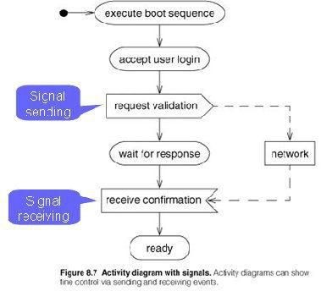
Sending and Receiving signals

Slide 79
Sending and Receiving signals
The UML shows the sending of a signal as a convex pentagon. when the preceding activity
completes , the signal is sent, then the next activity started.
The UML shows the receiving of a signal as a concave pentagon. when the preceding activity completes , the recipient construct waits until the signal is received, then the next activity starts.

Slide 80
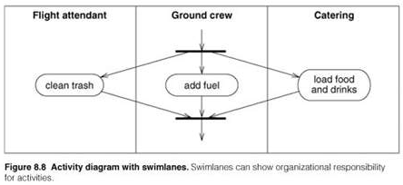

Swimlanes

Slide 81
Swimlanes
Swimlanes - Activity Diagrams that show activities by class. In a Business model, it is often useful to know which human organization is responsible for an activity. Sales, finance, marketing and purchasing etc.
Arrange activity diagrams into vertical zones separated by lines.
You can show show such partitioning is called swimlane. Each column is called swimlane by analogy to a swimming pool. placing an activity within the swimlane indicates that is performed by person or person with organizations.
Each zone represents the responsibilities of a particular class. (in this example, a particular department)

Slide 82

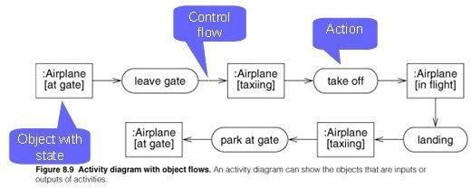
Object Flows

Slide 83
Object Flows
Its very helpful to identify relationship in between an operations and objects that are its argument and input values.
Frequently the same object goes through several sates during its life time. the same object may be an input or to an output from several activities .
UML shows an object value in particular state by placing the state name in square brackets. In fig airplane goes through several states as it leaves the gate, flies, and then lands again.

